Slide 1


Wine Quality Dataset Analysis
Harsh More – Project Lead
Vedanth Parikh – Group Member
B.Tech Mechanical
MIT Manipal

Slide 2

PROBLEM STATEMENT
The goal of this project is to analyze the Wine Quality dataset and understand how various physicochemical properties influence wine quality.
We aim to build a predictive neural network model that can estimate wine quality based on these features.

Slide 3
Objectives
• Explore and understand the dataset
• Visualize feature distributions and data trends
• Preprocess and normalize the data
• Build a neural network model for wine quality prediction
• Train the model for 100 epochs and evaluate performance
• Compare predictions with actual quality scores

Slide 4
Dataset Description
• Dataset: Wine Quality (UCI Machine Learning Repository)
• Type: Red & White wine chemical properties
• Total Features: 11 physicochemical inputs
• Target Variable: Quality score (0–10)
• Common features: pH, alcohol, sulphates, acidity, residual sugar, density, etc.

Slide 5

Methodology
Data loading & inspection
Handling missing values
Feature scaling
Exploratory Data Analysis (EDA)
Neural network model creation using TensorFlow/Keras
Training for 100 epochs
Performance evaluation (Loss, MAE, predictions)

Slide 6
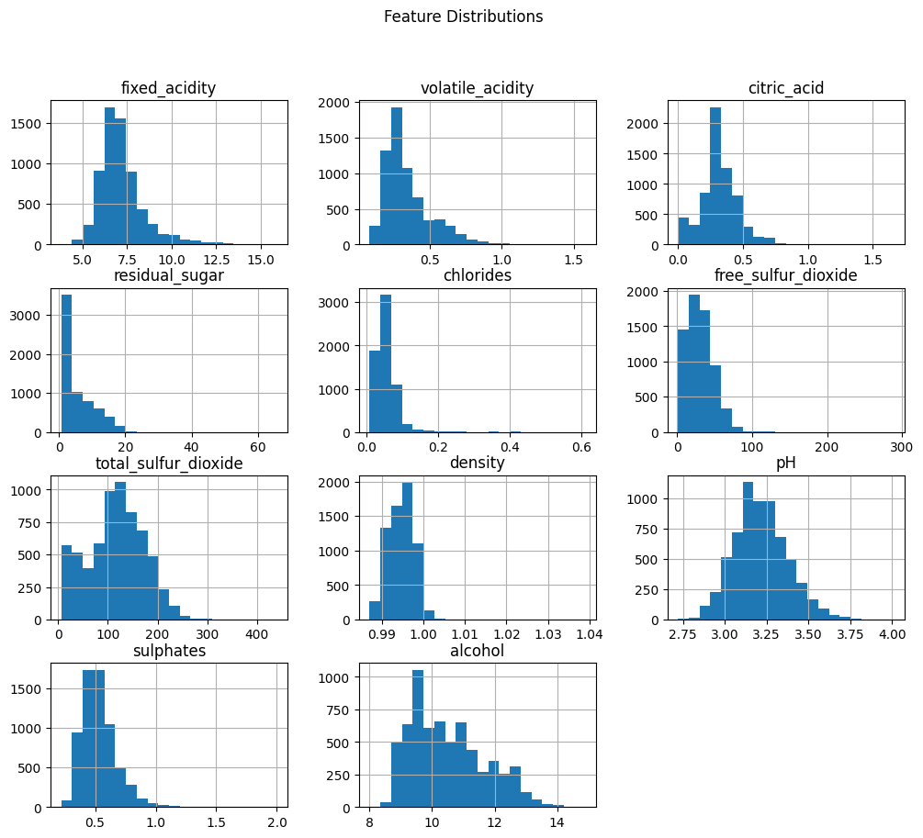
Feature Distributions
Description:
Shows how key physicochemical features such as acidity, chlorides, sulphates, density, and alcohol are distributed across the dataset.

Slide 7
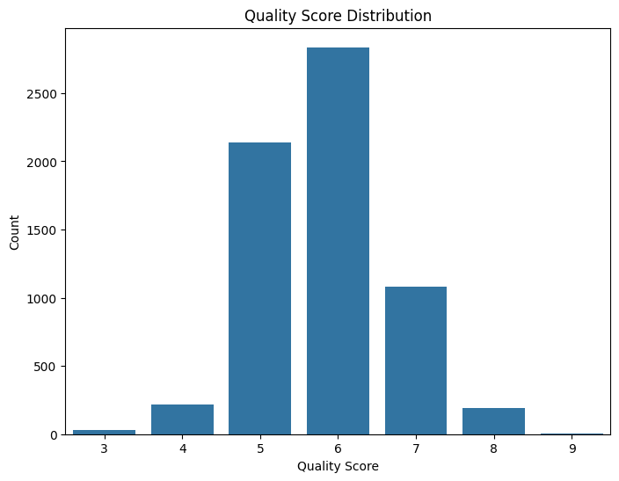
Quality Score Distribution
Description:
Wine quality scores mostly lie between 5 and 7, indicating a mid-range quality concentration.

Slide 8
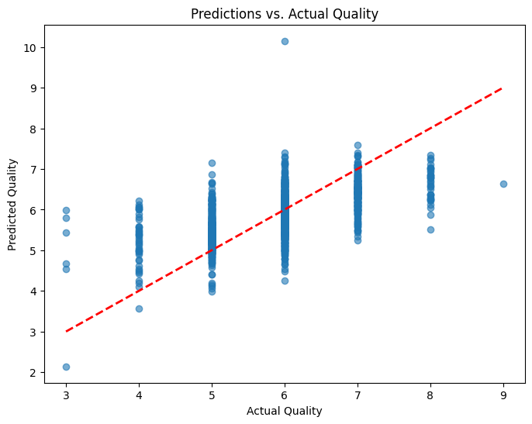
Predictions vs Actual
Observations:
• Predictions follow the general trend of actual scores
• Some variance exists due to overlapping feature ranges
• Model performs reasonably well for mid-range quality scores

Slide 9
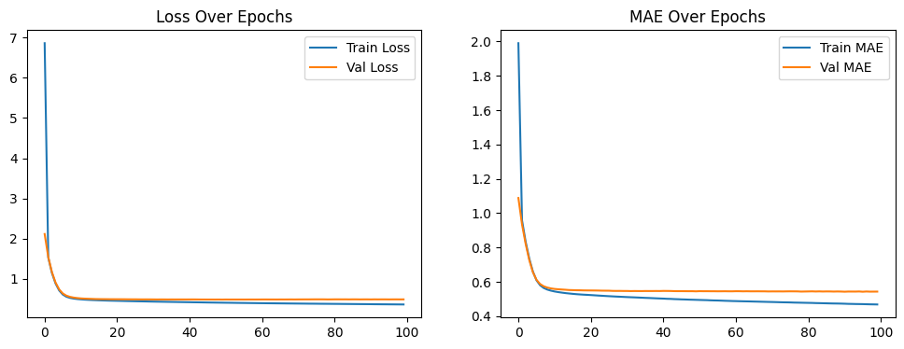
Training Curves (Loss & MAE)
Observations:
• Training and validation loss decrease sharply within first 20 epochs
• MAE stabilizes after ~20 epochs
• Model shows no major overfitting

Slide 10
Key Findings
Strong skew in several chemical properties
Alcohol and sulphates correlate positively with wine quality
The neural network model learns effectively over 100 epochs
Predictive performance is stable and consistent
Mid-quality wines are the most common (5–7 range)

Slide 11
Technologies Used
Google Colab – Coding & training
Python
Pandas – Data manipulation
Matplotlib/Seaborn – Visualizations
TensorFlow/Keras – Neural network model
GitHub – Version control & documentation

Slide 12
Model Performance Across Different Epochs
To understand how training duration affects model performance, the neural network was trained with multiple epoch settings.
Epochs vs MSE:
• 5 Epochs → 0.7600 MSE
• 10 Epochs → 0.5458 MSE
• 20 Epochs → 0.4985 MSE
• 50 Epochs → 0.4904 MSE
• 100 Epochs → 0.4893 MSE
Observations:
• Model improves rapidly between 5 → 20 epochs
• After ~50 epochs, improvements are very small
• 100 epochs gives the best result, but only slightly better than 50
• Performance plateaus after ~50 epochs (diminishing returns)
• 1000 epochs was attempted, but the runtime caused the browser to freeze

Slide 13

GitHub repository
Repository Name:Wine-Quality-Predictor
URL: https://github.com/CosmicStorm09/Wine-Quality-Predictor
Contents:
• Notebook (.ipynb)
• Python script
• Results (graphs)
• Presentation
• README & License

Slide 14
Thank You!
Harsh More
B.Tech Mechanical
MIT Manipal
Contact – harsh15.mitmpl2022@learner.manipal.edu
.
.

